Slide 1
FYP5: Object Detection, Tracking and Suspicious Activity Recognition for Maritime Surveillance using Thermal Vision

Slide 2
Weekly Tasks
Activity Detection
Developing the Control System and the Stabilizer

Slide 3
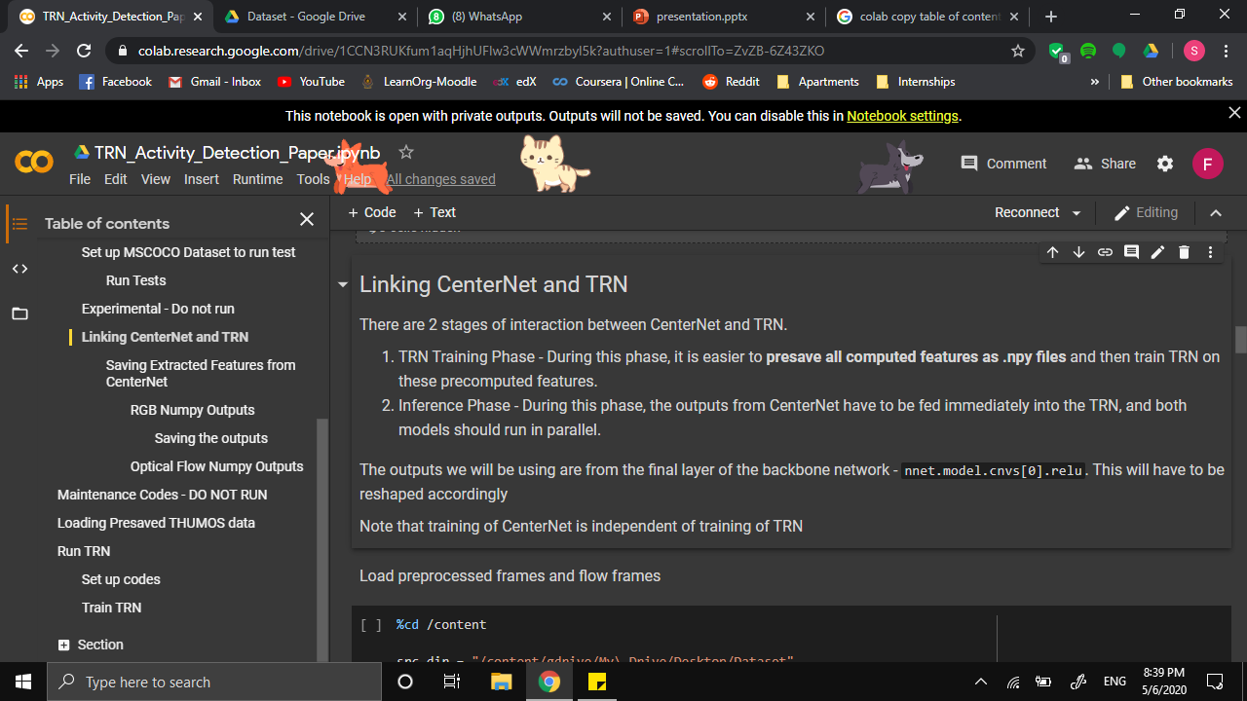
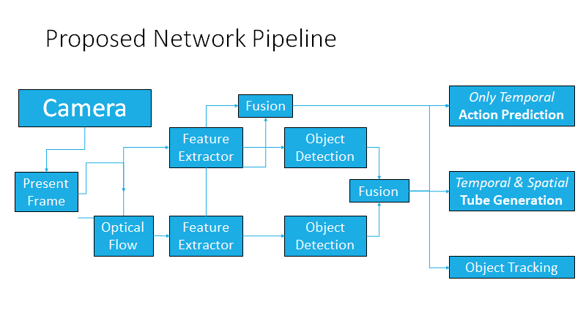

Slide 4
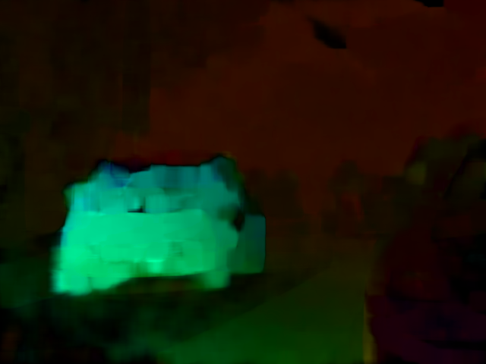
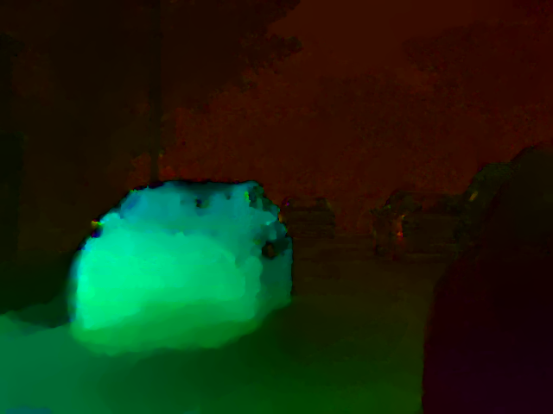
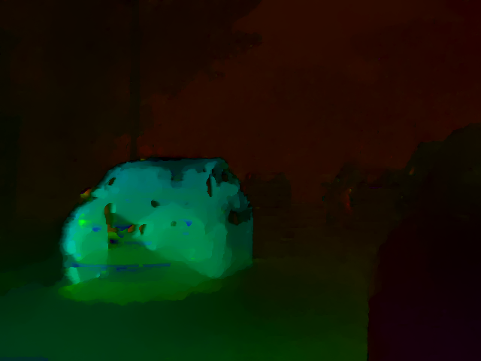
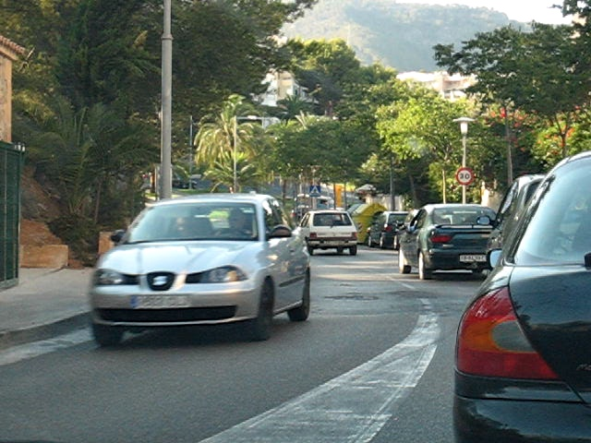
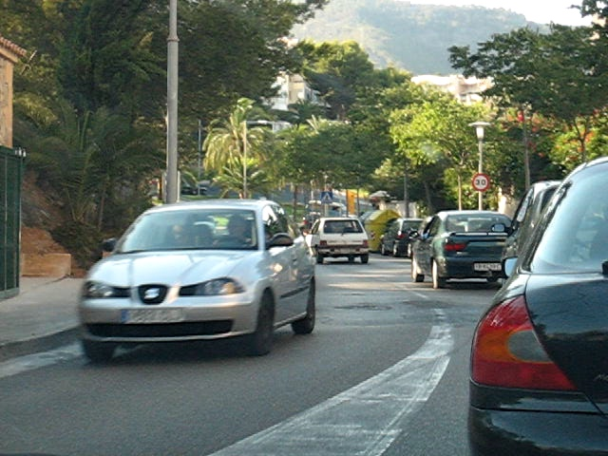



Benchmarking Optical Flow Algorithms
1. Farneback
2. Coarse-to-fine
3. TVL1
4. FlowNet 1.0 - FlownetC
5. FlowNet 1.0 - FlownetS with BN
6. FlowNet 2.0 - Fused Model

Slide 5
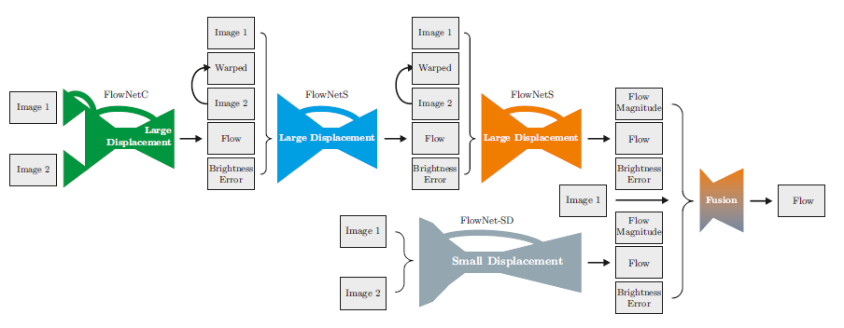
FlowNet 2.0: Evolution of Optical Flow Estimation with Deep Networks Eddy Ilg, Nikolaus Mayer, Tonmoy Saikia, Margret Keuper, Alexey Dosovitskiy, Thomas Brox University of Freiburg, Germany

Slide 6
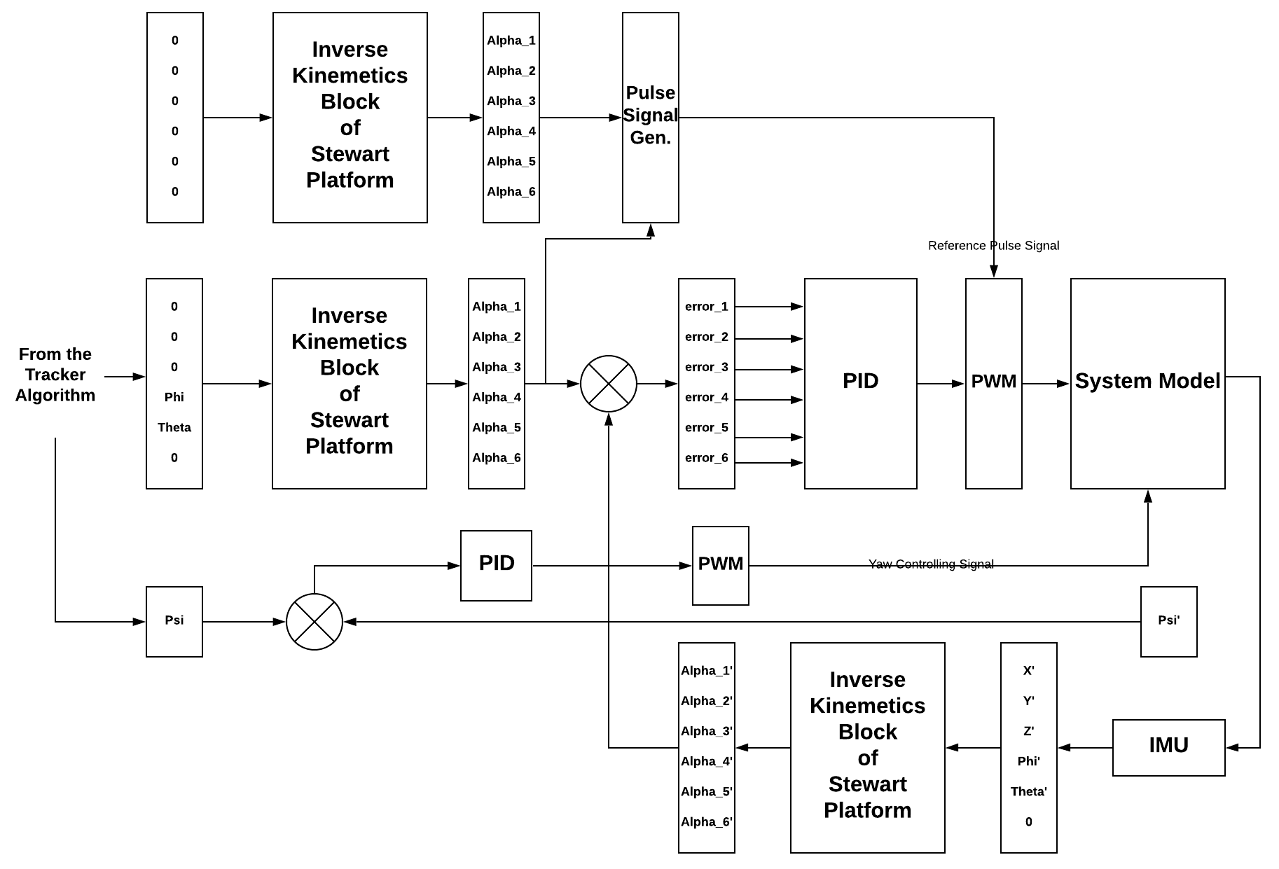
Servo angles for Home Position
Control System for Stewart Platform – 6DOF
Control signal creation for yaw

Slide 7
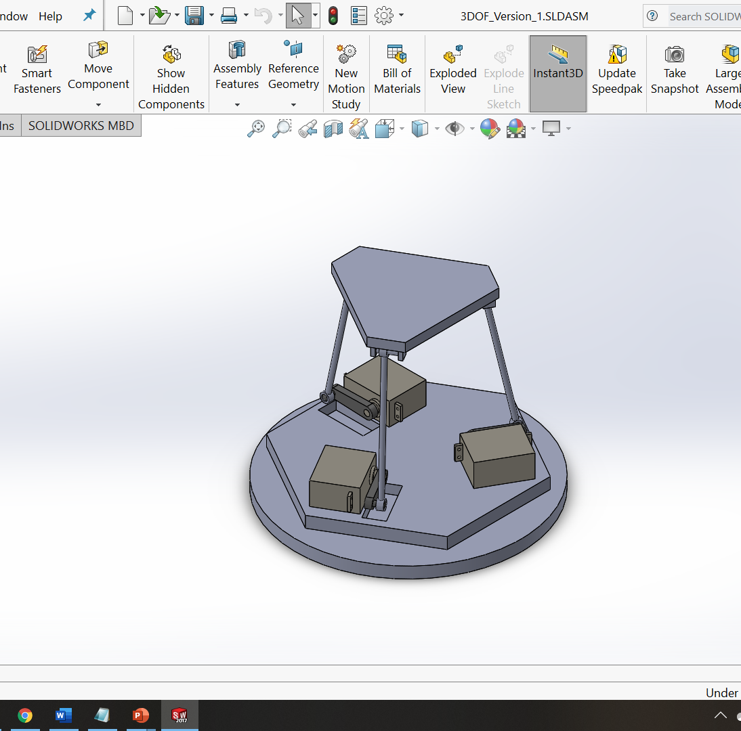
3 DOF Stewart Platform

Slide 8
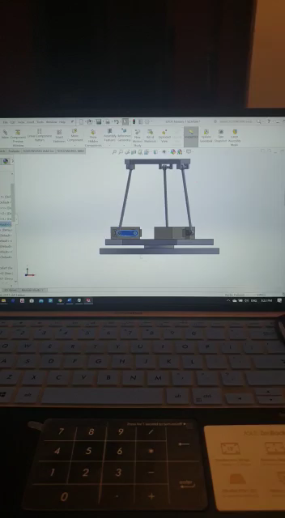
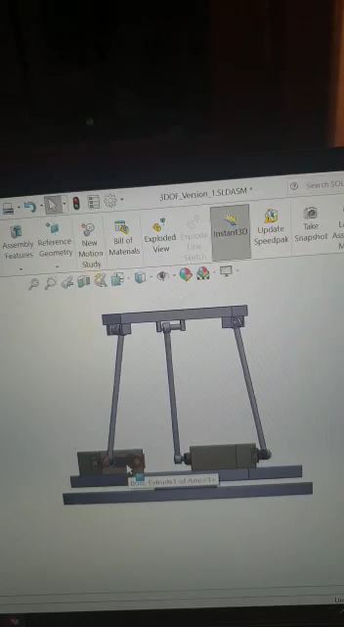
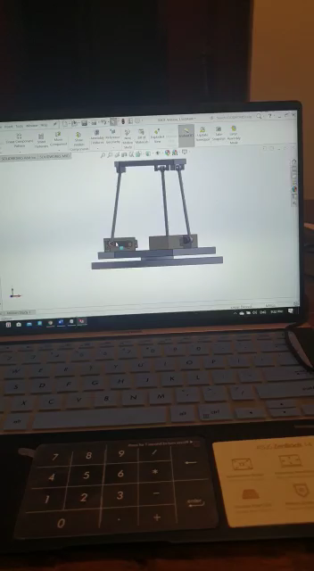

Slide 9

Tasks for next week
TRN network training completion on Thumos-14 and test its accuracy
Hopefully to train/test TRNs with different feature extractors and optical flow algos.
Try to simulate the 3 DOF Stewart Platform wrt various servo motor configurations.

